Slide 1

NSG Pilkington – University of Liverpool Machine Learning Project: Input data pre-processing
Dr. Peter Green
Diego Echeverria
Risk Institute,
School of Engineering
11/08/2020

Slide 2
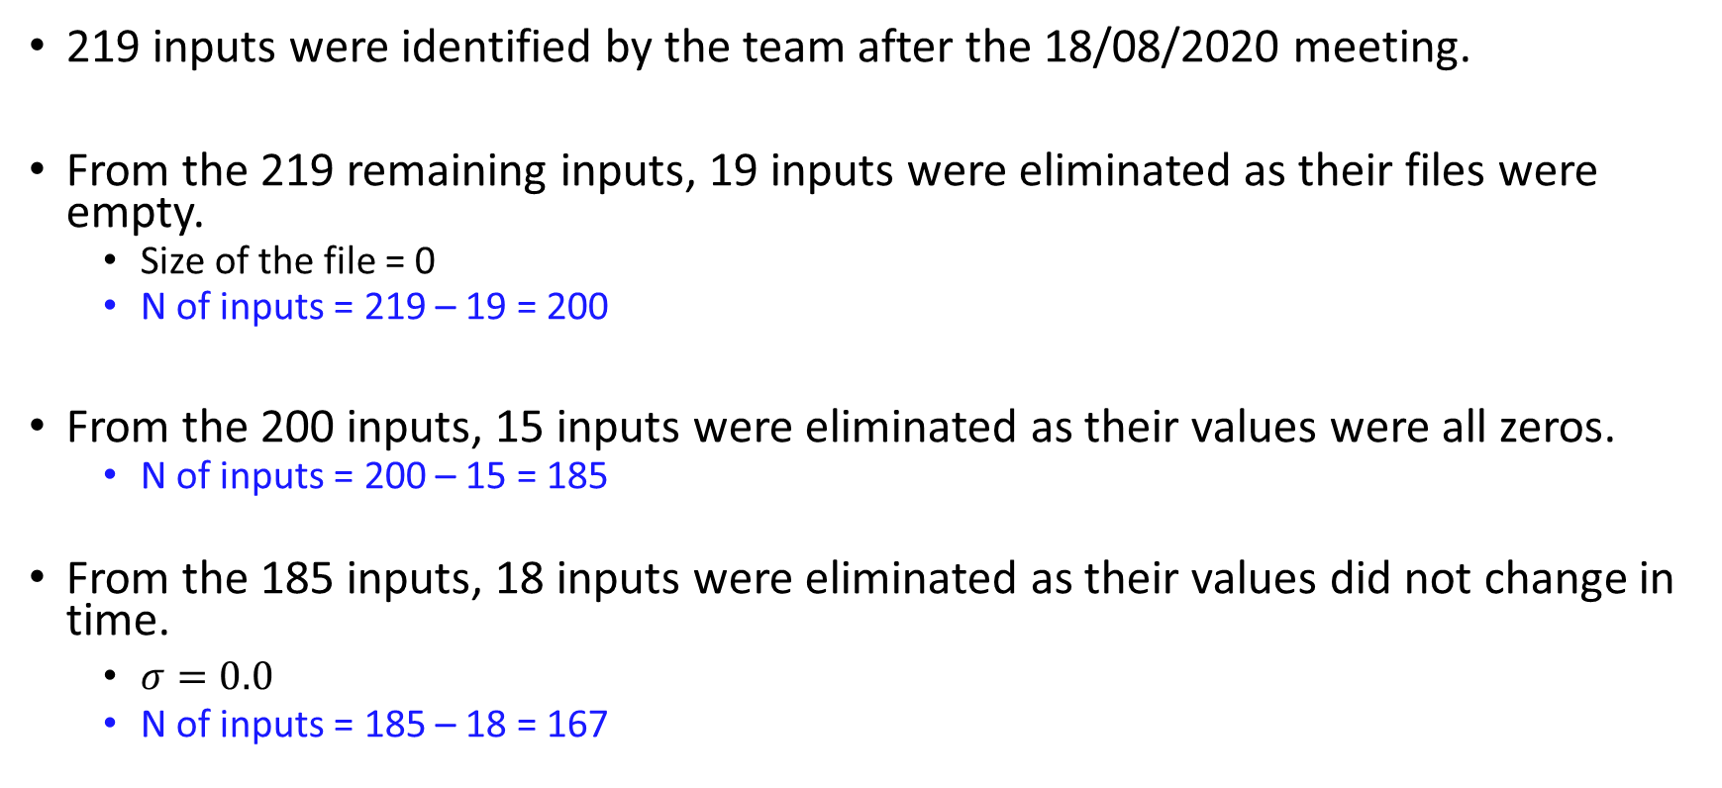
From the Furnace inputs excel file
219 inputs were identified by the team after the 18/08/2020 meeting.
From the 219 remaining inputs, 19 inputs were eliminated as their files were empty.
Size of the file = 0
N of inputs = 219 – 19 = 200
From the 200 inputs, 15 inputs were eliminated as their values were all zeros.
N of inputs = 200 – 15 = 185
From the 185 inputs, 18 inputs were eliminated as their values did not change in time.
$σ=0.0$
N of inputs = 185 – 18 = 167

Slide 3
Empty files
File: TagID 10132 ignored as empty
File: TagID 11025 ignored as empty
File: TagID 12737 ignored as empty
File: TagID 12738 ignored as empty
File: TagID 20301 ignored as empty
File: TagID 20302 ignored as empty
File: TagID 20303 ignored as empty
File: TagID 20304 ignored as empty
File: TagID 20305 ignored as empty
File: TagID 20306 ignored as empty
File: TagID 20307 ignored as empty
File: TagID 20308 ignored as empty
File: TagID 20309 ignored as empty
File: TagID 20310 ignored as empty
File: TagID 20311 ignored as empty
File: TagID 20313 ignored as empty
File: TagID 20314 ignored as empty
File: TagID 30790 ignored as empty
File: TagID 3737 ignored as empty
19 inputs eliminated
A description of each Tag sensor can be found in the “Eliminated_Tag_data” excel file

Slide 4
Inputs that did not change in time
TagID 12783
TagID 12784
TagID 12785
TagID 12786
TagID 12787
TagID 12788
TagID 12789
TagID 12790
TagID 12791
TagID 12792
TagID 12793
TagID 12794
TagID 12795
TagID 12796
TagID 12797
TagID 12798
TagID 15032
TagID 233
18 inputs eliminated
A description of each Tag sensor can be found in the “Eliminated_Tag_data” excel file

Slide 5
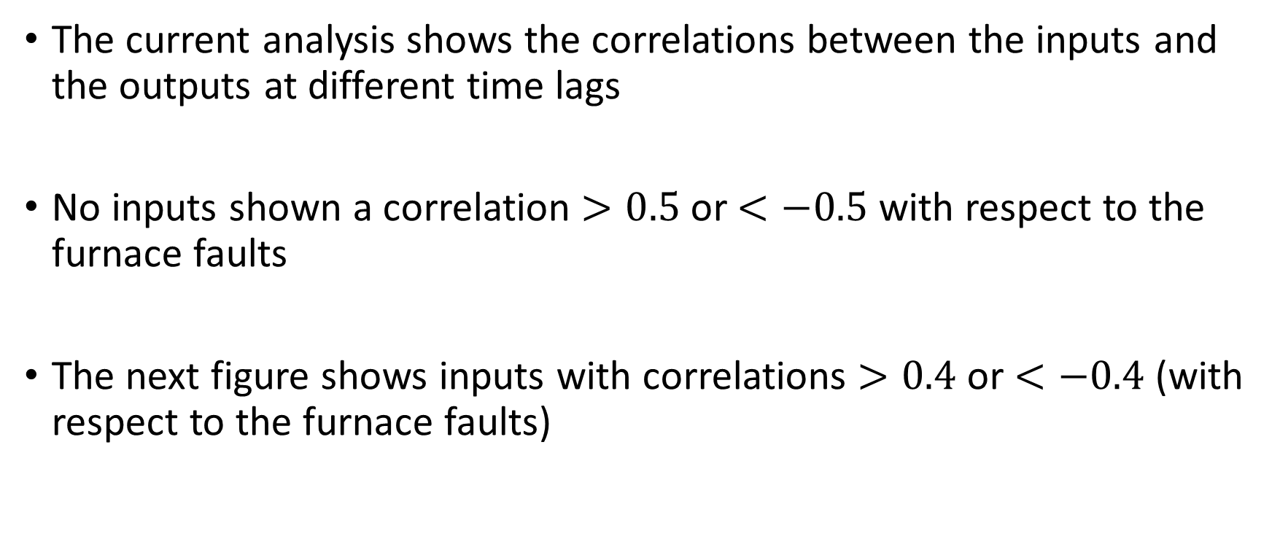
Feature selection analysis
The current analysis shows the correlations between the inputs and the outputs at different time lags
No inputs shown a correlation $>0.5$ or $<−0.5$ with respect to the furnace faults
The next figure shows inputs with correlations $>0.4$ or $<−0.4$ (with respect to the furnace faults)

Slide 6
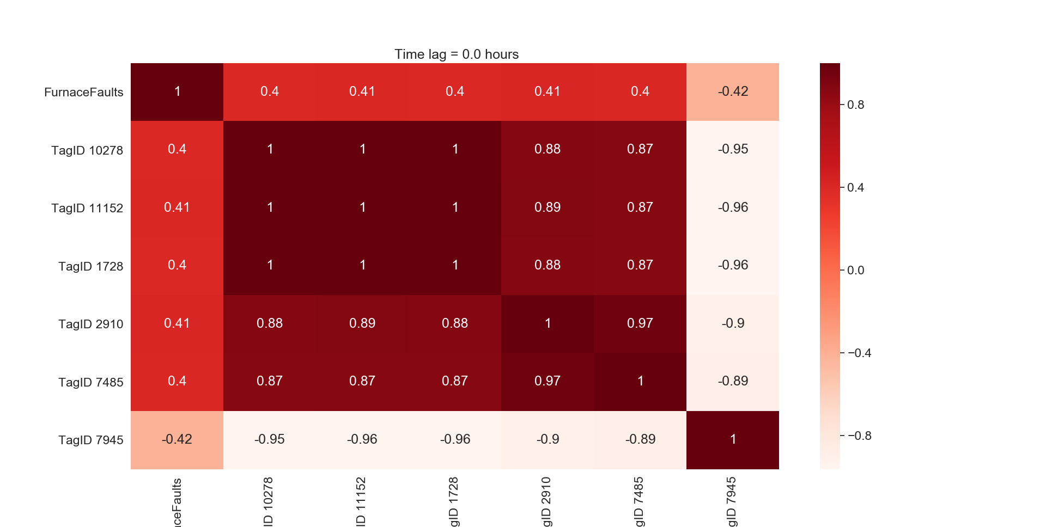
Feature selection analysis

Slide 7
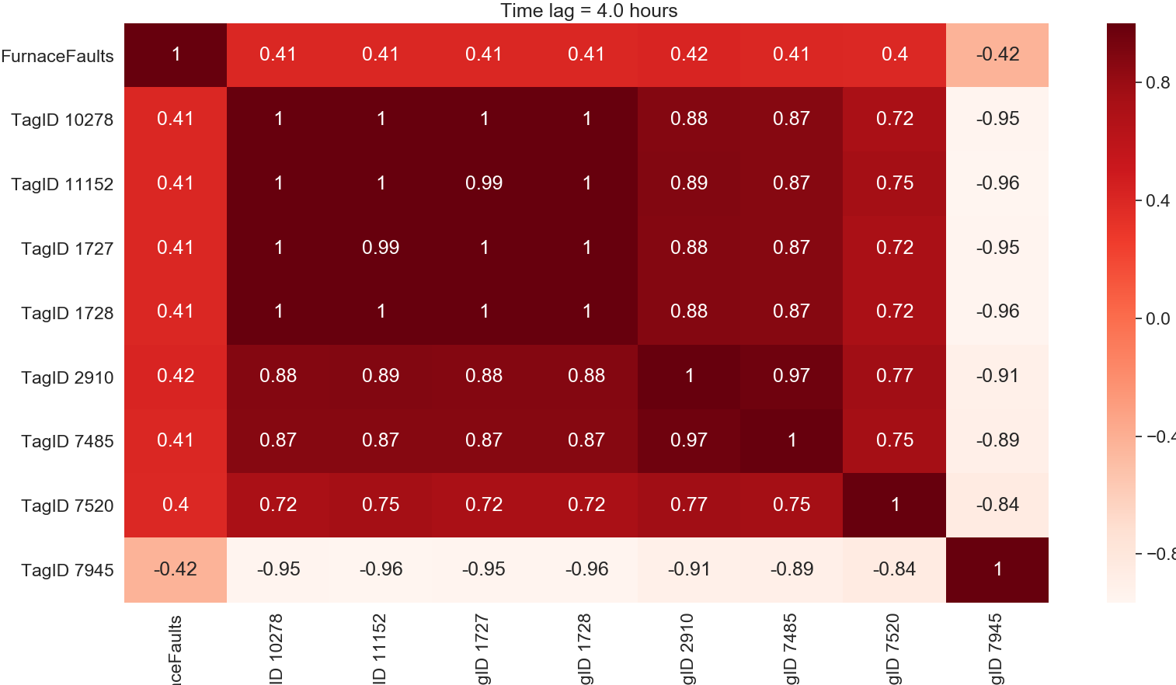
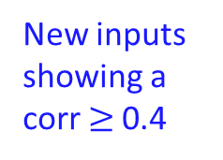
Feature selection analysis
New inputs showing a corr $≥$0.4

Slide 8
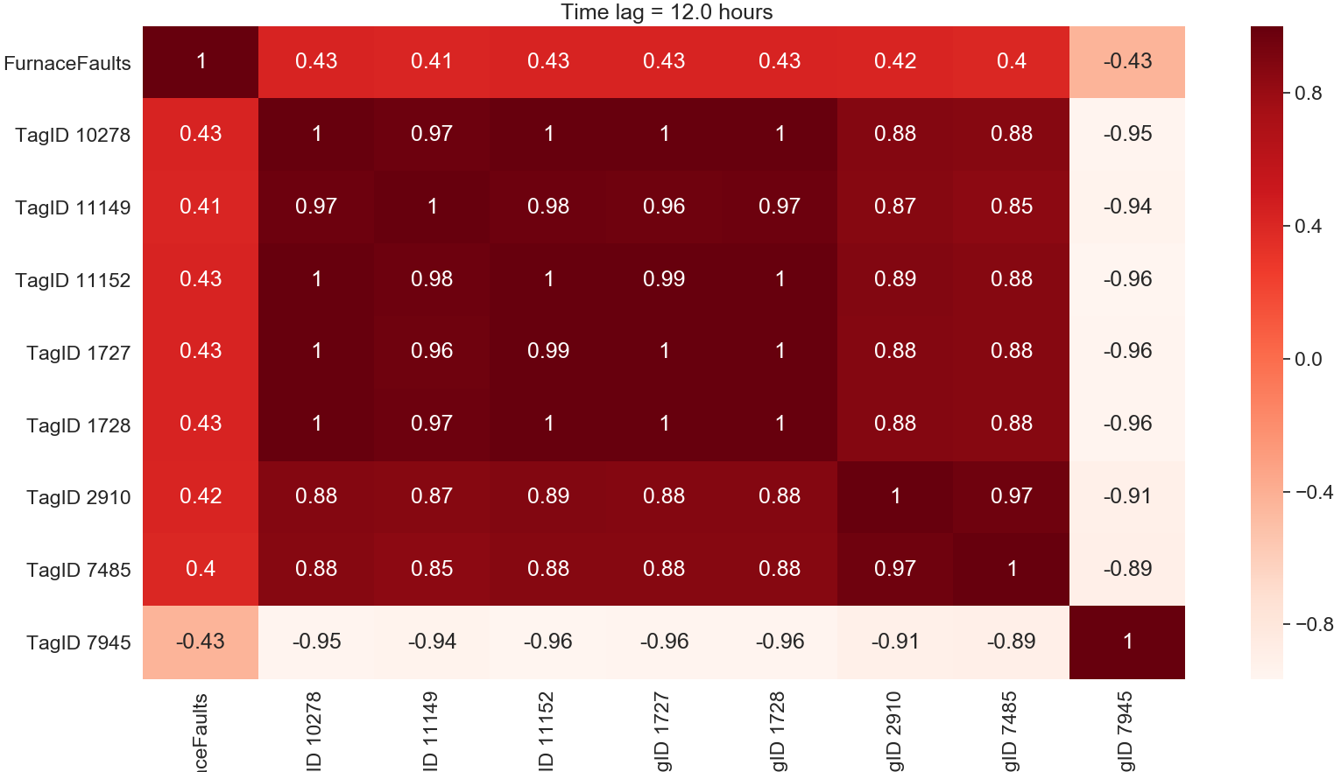
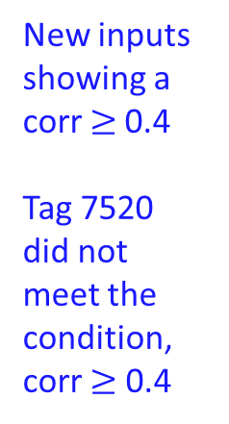
Feature selection analysis
New inputs showing a corr $≥$0.4
Tag 7520 did not meet the condition,
corr $≥$ 0.4

Slide 9

Feature selection analysis

Slide 10
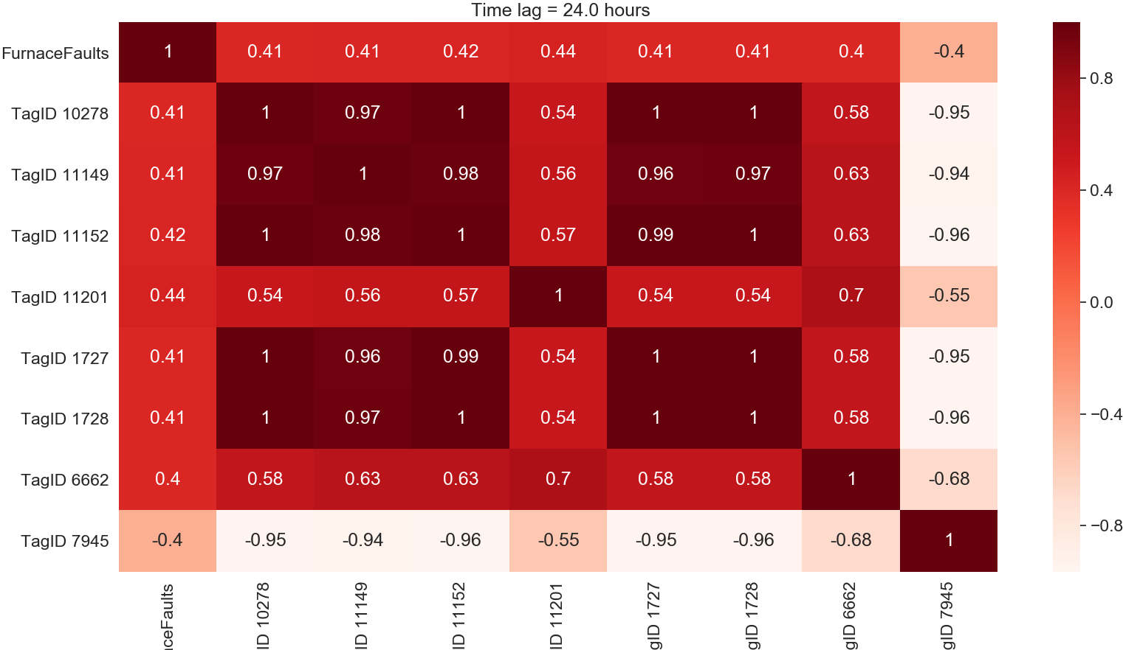
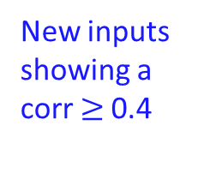
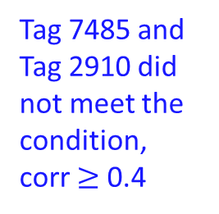
Feature selection analysis
Tag 7485 and
Tag 2910 did not meet the condition,
corr $≥$ 0.4
New inputs showing a corr $≥$0.4

Slide 11
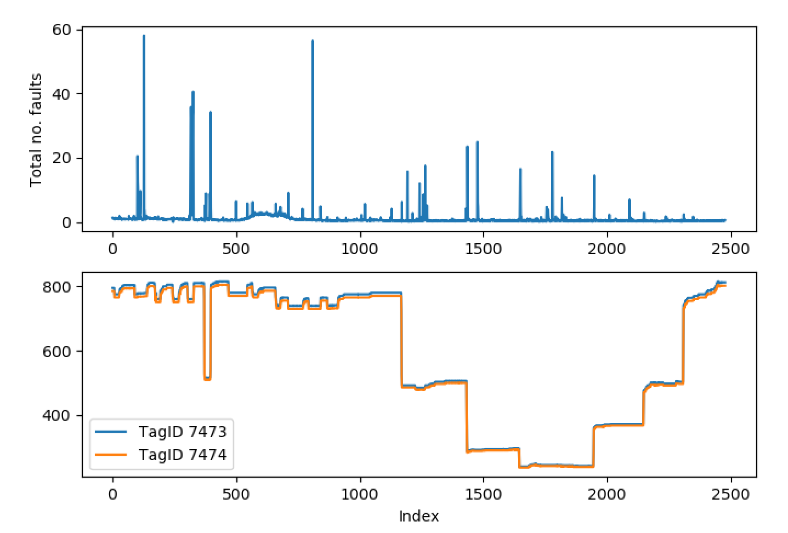

Eliminating highly correlated inputs
Highly correlated Tag data:
The correlation coefficient (corr = [1, -1]) between the Tag sensors is high, for instance, $corr >0.9$

Slide 12
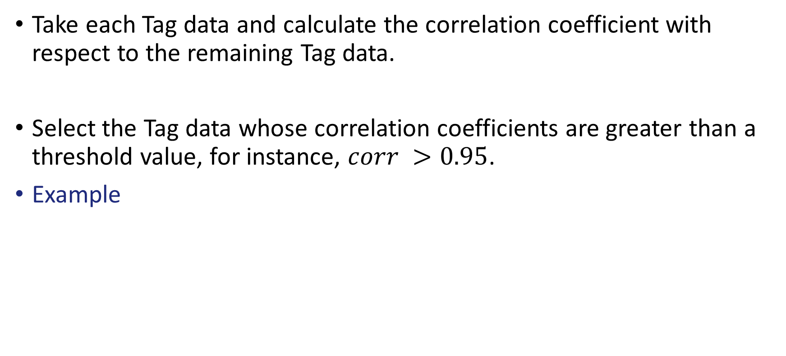
Eliminating highly correlated inputs
Take each Tag data and calculate the correlation coefficient with respect to the remaining Tag data.
Select the Tag data whose correlation coefficients are greater than a threshold value, for instance, $corr >0.95$.
Example
TagID 10271
Correlated tags:
Name: Corr
TagID 11148 0.980426
TagID 2910 0.964043
TagID 7485 0.964913

Slide 13
Eliminating highly correlated inputs
Keep only the Tag data whose correlation coefficient with respect to the output (Furnace Faults) is the highest.
Correlation with respect to the output (Furnace Faults data):
Name Corr
TagID 10271 0.371088
TagID 11148 0.361814
TagID 2910 0.416434
TagID 7485 0.406529

Slide 14
Eliminating highly correlated inputs
Keep only the Tag data whose correlation coefficient with respect to the output (Furnace Faults) is the highest.
Correlation with respect to the output (Furnace Faults data):
Name Corr
TagID 10271 0.371088
TagID 11148 0.361814
TagID 2910 0.416434
TagID 7485 0.406529

Slide 15
Lehr drive speed
Correlations with respect to the output (furnace faults) at different time lags
Lehr drive speed at a time lag = 0.0 hours
Input Corr
TagID 7473 0.108454
TagID 7474 0.108423
TagID 7658 0.112865
Lehr drive speed at a time lag = 24 hours
Input Corr
TagID 7473 0.123031
TagID 7474 0.122999
TagID 7658 0.127584
Suggesting to eliminate TagID 7473, TagID 7474 and keep TagID 7658

Slide 16

Eliminating highly correlated inputs
For the current analysis we use a time lag equals to 24 hours.
Eliminating inputs whose correlation is $>0.9$
68 inputs were eliminated
N of inputs = 167 – 70 = 97

Slide 17
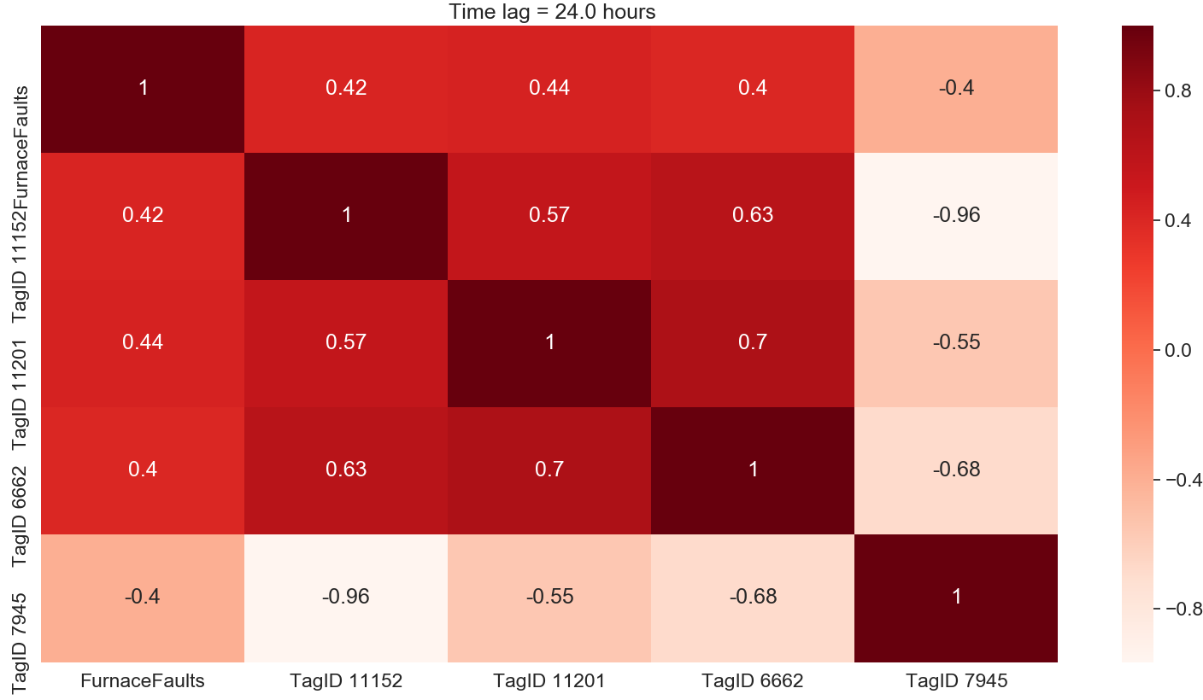
Feature selection analysis after eliminating highly correlated inputs

Slide 18
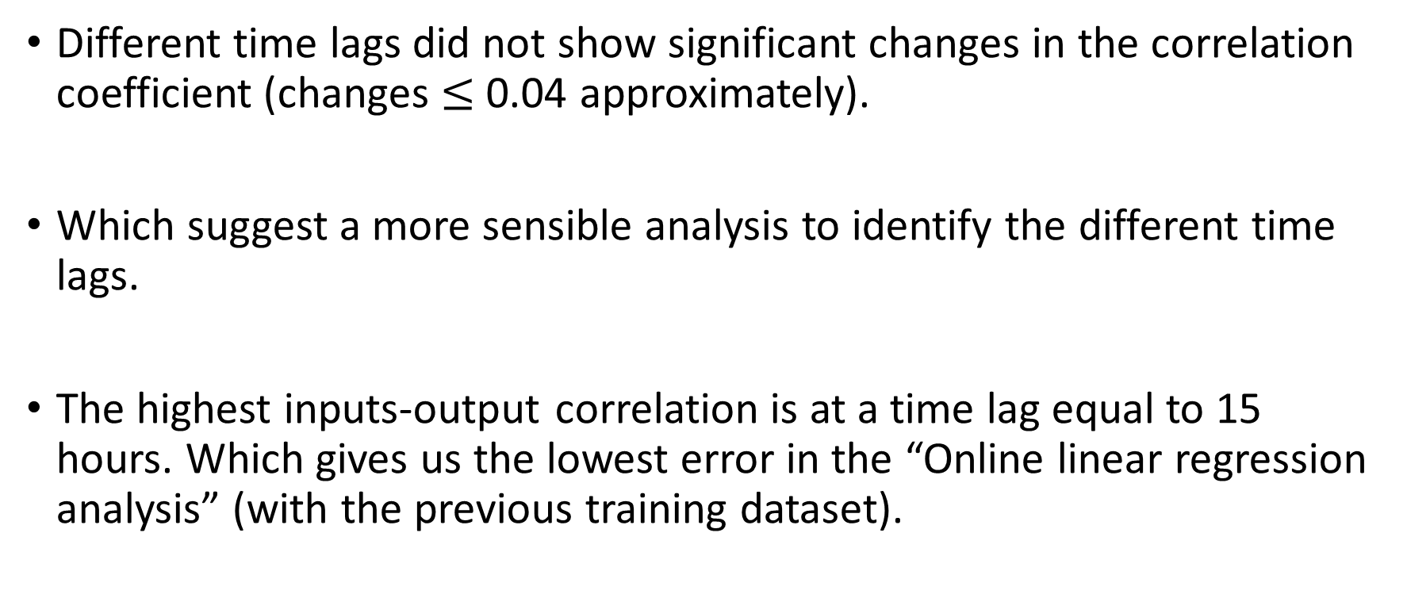
Conclusions
Different time lags did not show significant changes in the correlation coefficient (changes $≤$ 0.04 approximately).
Which suggest a more sensible analysis to identify the different time lags.
The highest inputs-output correlation is at a time lag equal to 15 hours. Which gives us the lowest error in the “Online linear regression analysis” (with the previous training dataset).

Slide 19
Thank you for your attention. ANY QUESTIONS?

